Slide 1
Capstone Project
Telecom Churn EDA
Contribution:
Mohmmad sohel

Slide 2

Business Overview
Orange S.A., formerly France Telecom S.A.
Presence in 26 countries.
It has 266 million customers worldwide.
Revenue : € 42.5 billion (FY 2021)
Business : Mobile, Broadband, Pay-TV services, Cloud computing,
Cybersecurity, & IoT
This dataset consists of cleaned customer activity data (features), along with
a churn label specifying whether a customer cancelled the subscription.

Slide 3







Problem Statement & Business Objective
Telecom churn analysis is the process of identifying customers who are likely to cancel their service or switch to a different service provider. This is an important problem for telecom companies, as churn can have a significant impact on their revenue and profitability.
Business Objective
Identifying the key cause of the customer churn
Provide steps to retain the valuable customer
Methodology
Data Acquisition &
Overview
Data
cleaning
Data
wrangling
Data
visualization
Conclusion

Slide 4
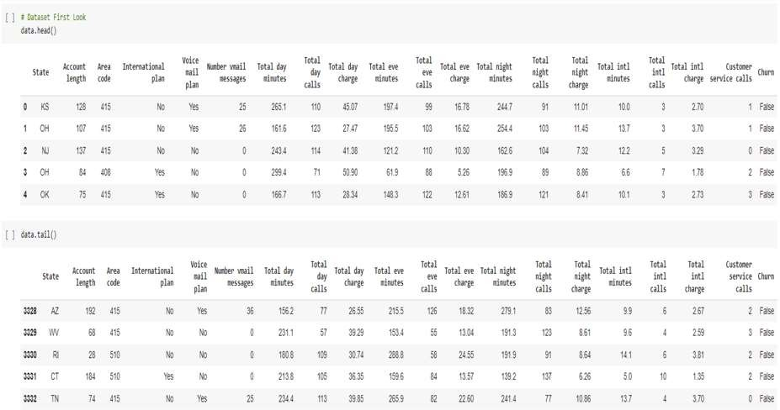
Dataset First look
3333 Rows and 20 Columns

Slide 5
Data Summary
Telecom Dataset
Numerical
Variables
Categorical
Variables
Dependent
Variable(output)
Account length
Number vmail messages
Total day minutes
Total day calls
Total day charge
Total eve minutes
Total eve calls
Total eve charge
Total night minutes
Total night calls
Total night charge
Total intl minutes
Total intl calls
Total intl charge
Customer service calls
State
Area Code
International Plan
Voicemail Plan
1) Churn

Slide 6
Variables
Variable | Description | Data type | Unique Values | Min | Max
State | Categorical for 50 states and capital DC | object | 51 | NaN | NaN
Account Length | Number of days account has been active | int64 | 212 | 1 | 243
Area Code | Code Number of Area having some States included in each area code. | int64 | 3 (408,415,510) | NaN | NaN
International Plan | Activated International plan or not | object | 2 (Yes, No) | NaN | NaN
Voicemail plan | Activated voicemail plan or not | object | 2 (Yes, No) | NaN | NaN
Number vmail messages | Count of vmail messages sent | int64 | 46 | 0 | 51
Total day minutes | Total minutes used during day time | float64 | 1667 | 0 | 350.8
Total day calls | Total number of calls during day time | int64 | 119 | 0 | 165.00
Total day charge | Total charge during day time | float64 | 1667 | 0 | 59.64

Slide 7
Variables(Contd.)
Variable | Description | Data type | Unique Values | Min | Max
Total eve minutes | Total minutes used during evening time | float64 | 1611 | 0 | 363.70
Total eve calls | Total number of calls during evening time | int64 | 123 | 0 | 170.00
Total eve charge | Total charge during evening time | float64 | 1440 | 0 | 30.91
Total night minutes | Total minutes used during night time | float64 | 1591 | 23.20 | 395.00
Total night calls | Total number of calls during night time | int64 | 120 | 33.0 | 175.00
Total night charge | Total charge during night time | float64 | 933 | 1.04 | 17.77
Total intl minutes | Total minutes used of international call | float64 | 162 | 0 | 20.00
Total intl calls | Total number of international calls | int64 | 21 | 0 | 20.00
Total intl charge | Total charge of international calls | float64 | 162 | 0 | 5.40
Customer Service Calls | Number of calls to customer service | int64 | 10 | 0 | 9
Churn | Customer churn | bool | 2 (True, False) | NaN | NaN

Slide 8
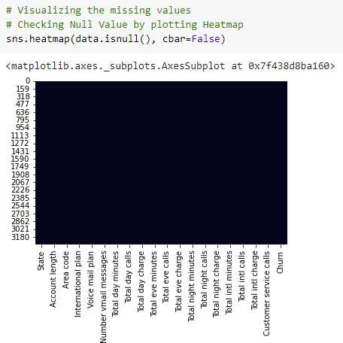

Data Cleaning
There are no missing values and duplicate values in
dataset.

Slide 9
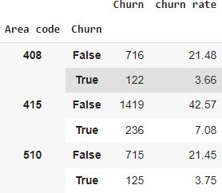

Data Wrangling
Customer Churn on the basis of Area code
Customer Churn on Whole
Dataset

Slide 10
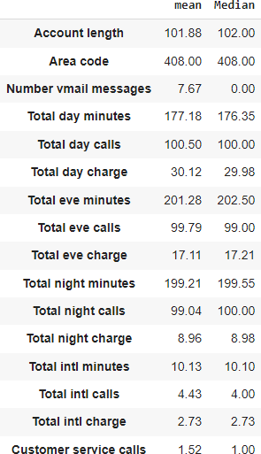
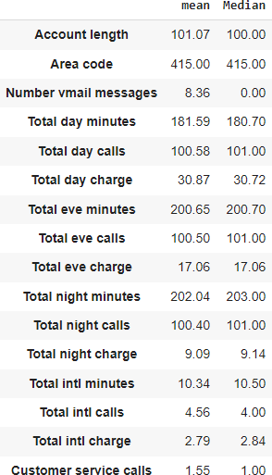

Data Wrangling(Contd.)
Area code 408
Area code 415
Area code 510

Slide 11
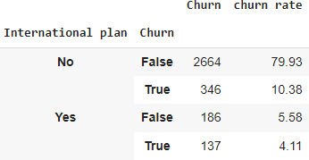
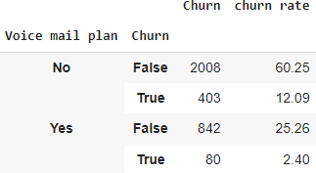
Data Wrangling(Contd.)
Those who has international plan their
churn rate is high.
Around 42 % customers are churned.
No such difference

Slide 12
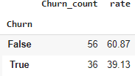


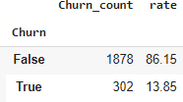
Data Wrangling(Contd.)
International + Voicemail
Only Voicemail
Only International
No International No Voicemail

Slide 13
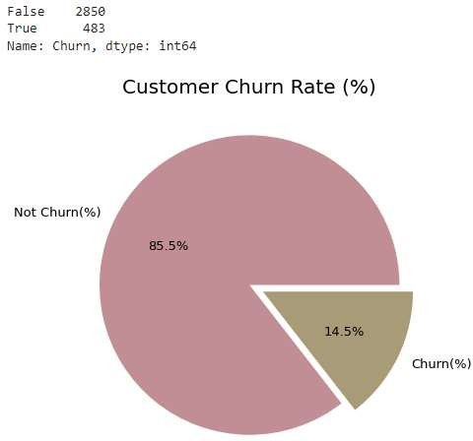
Data Visualization
Dependent Variable

Slide 14
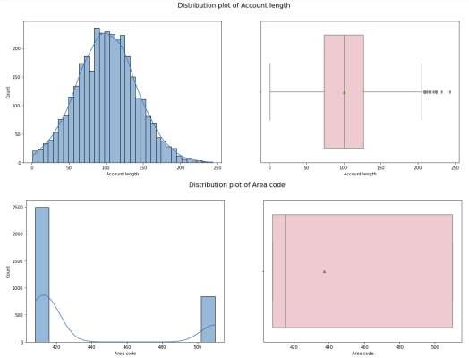
Data Visualization
Distribution Plot and Box plot (Univariate Analysis)

Slide 15
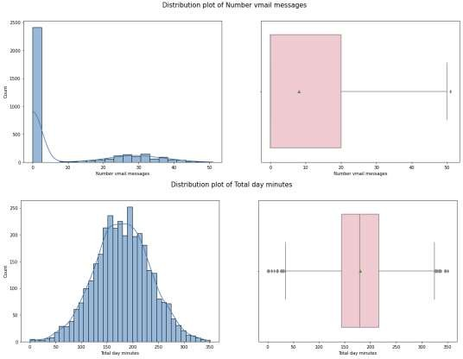
Data Visualization
Distribution Plot and Box plot(Contd.)

Slide 16
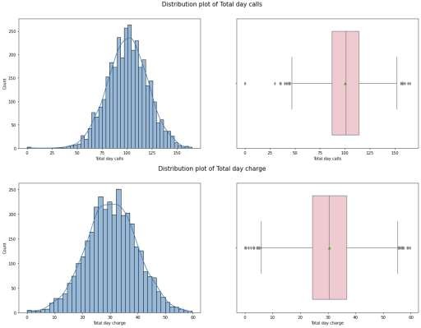
Data Visualization
Distribution Plot and Box plot(Contd.)

Slide 17
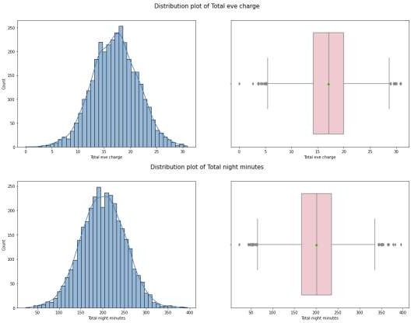
Data Visualization
Distribution Plot and Box plot(Contd.)

Slide 18
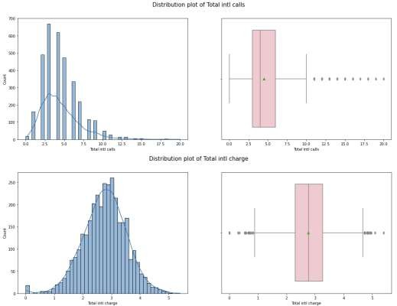
Data Visualization
Distribution Plot and Box plot(Contd.)

Slide 19
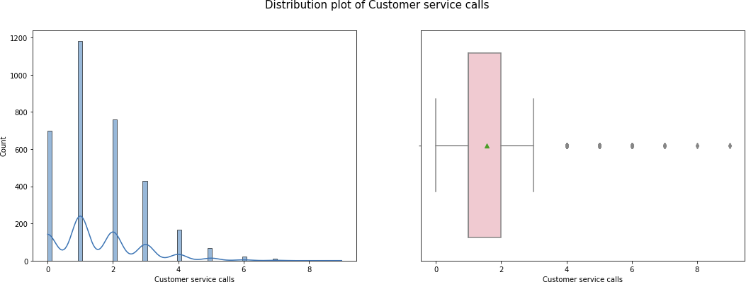
Data Visualization
Distribution Plot and Box plot(Contd.)

Slide 20
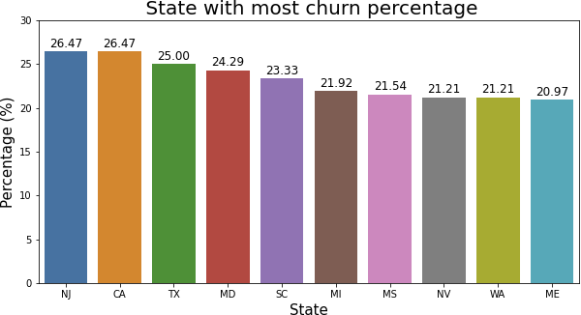
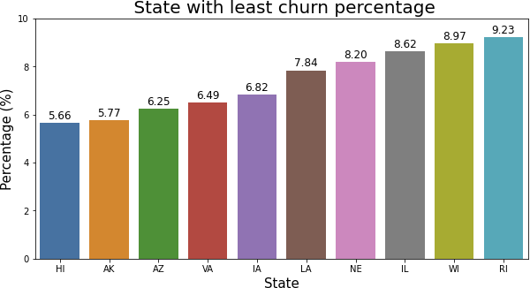
Data Visualization
State vs Average Churn Percentage (Bivariate Analysis)

Slide 21
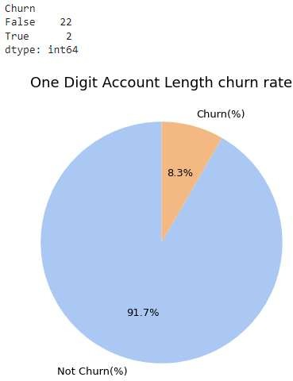
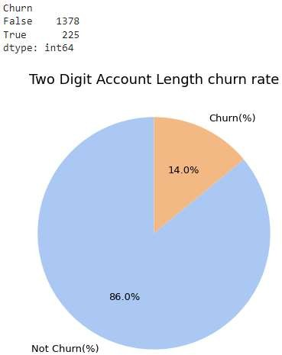
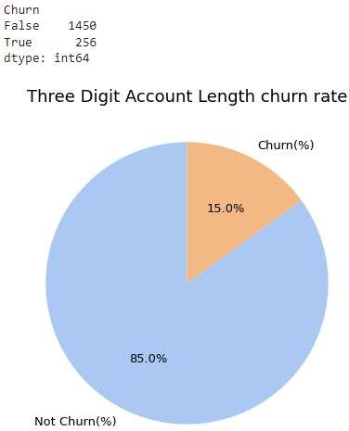
Data Visualization
Account Length Pie Chart

Slide 22
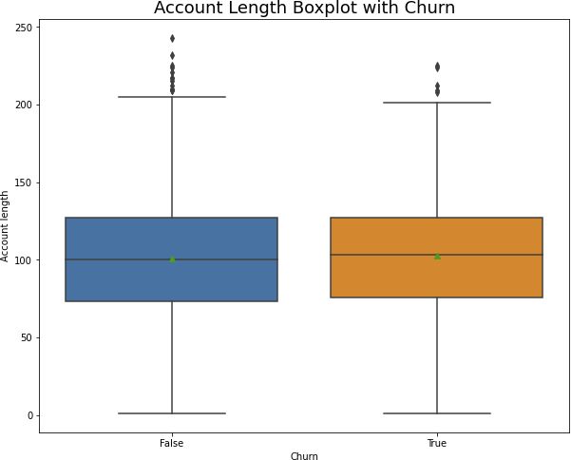
Data Visualization
Account Length with Churn Box Plot

Slide 23
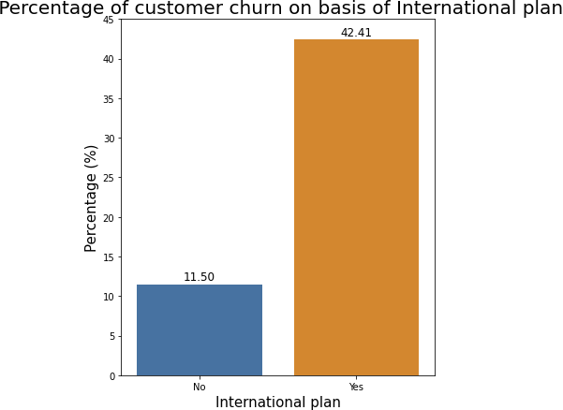
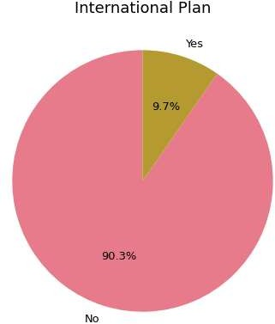
Data Visualization
International Plan

Slide 24
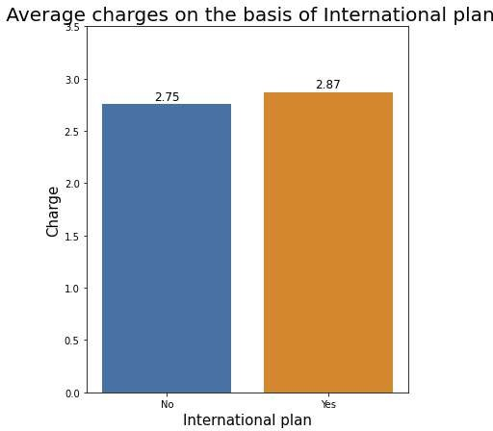
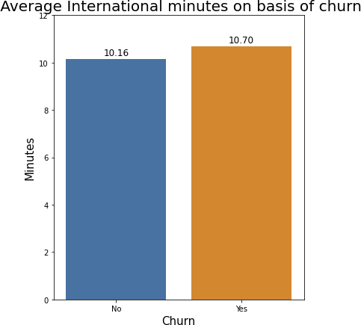
Data Visualization
International Plan(Contd.)

Slide 25
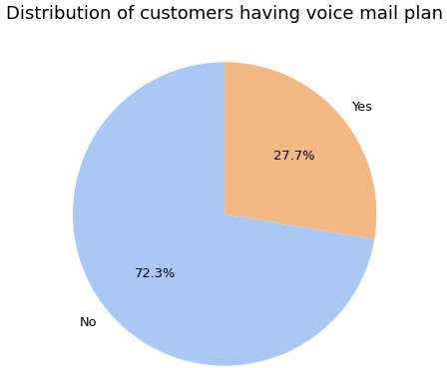
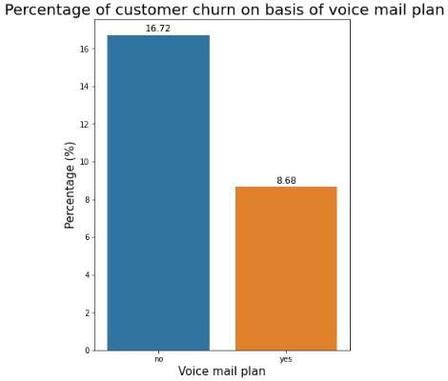
Data Visualization
Voicemail Plan

Slide 26
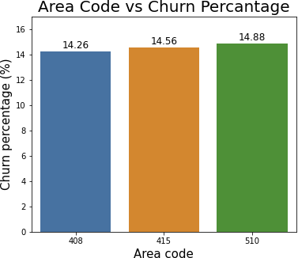
Data Visualization
Area code vs Churn Percentage

Slide 27
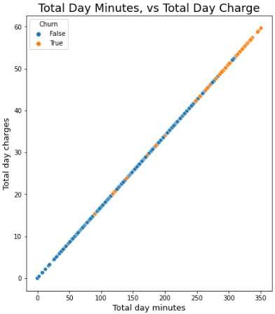
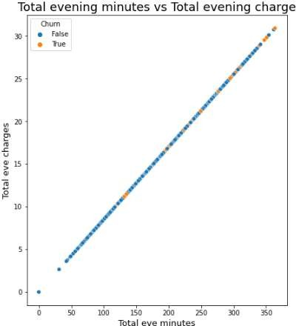
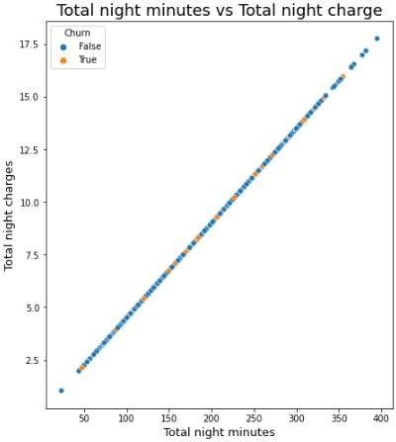
Data Visualization
Minute vs charge

Slide 28
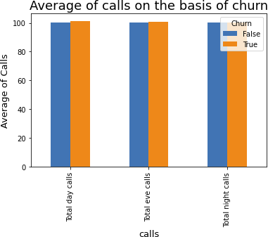
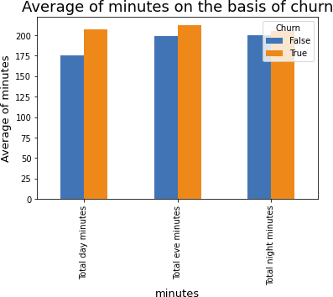
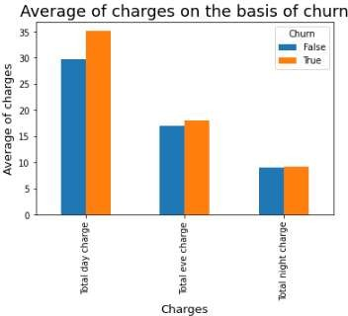
Data Visualization
Average of calls on the basis of churn

Slide 29
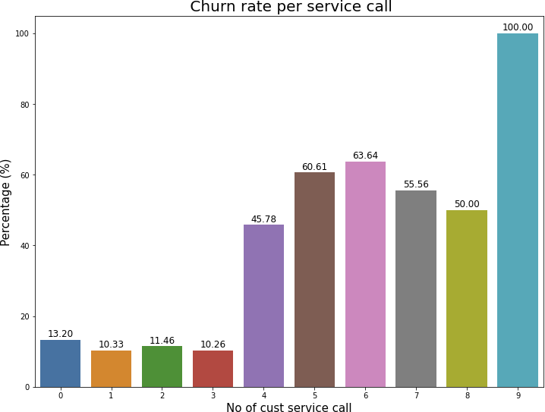
Data Visualization
Service Call vs Churn Percentage

Slide 30
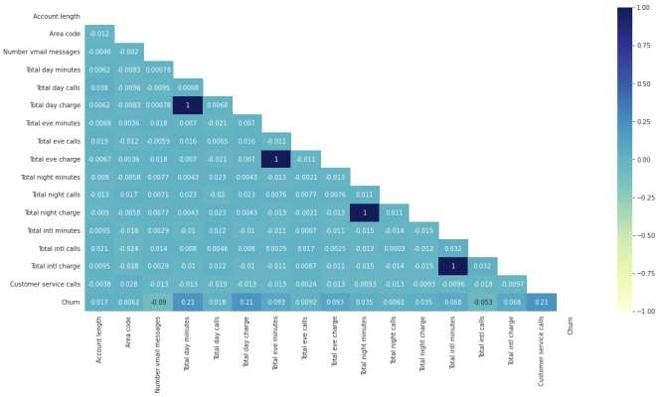
Data Visualization
Correlation Heatmap

Slide 31
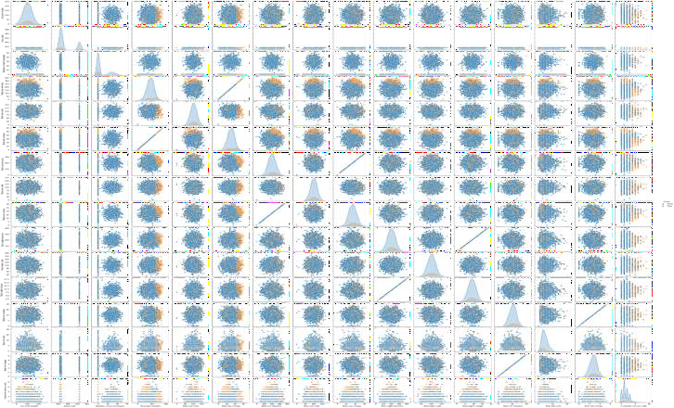
Data Visualization
Pair Plot

Slide 32
Conclusion
The four charge fields are directly related to the minute fields.
The area code may not be relevant and can be excluded.
Customers with the International Plan tend to churn more often.
Customers who have had four or more customer service calls churn significantly more than other customers.
Customers with high day and evening minute usage tend to churn at a higher rate.
There is no clear relationship between churn and the variables such as day calls,
evening calls, night calls, international calls, night minutes, international minutes,
account length, or voice mail messages.

Slide 33
Solution to Business Problem
Modify International Plan as the charge is same as normal one.
Be proactive with communication.
Ask for feedback often.
Periodically throw Offers to retain customers.
Look at the customers facing problem in the most churning states.
Lean into best customers.
Regular Server Maintenance.
Solving Poor Network Connectivity Issue.
Define a roadmap for new customers.
Analyze churn when it happens.
Stay competitive.

Slide 34
The End
Presented by:-
Mohmmad sohel
Thank You

